Slide 1


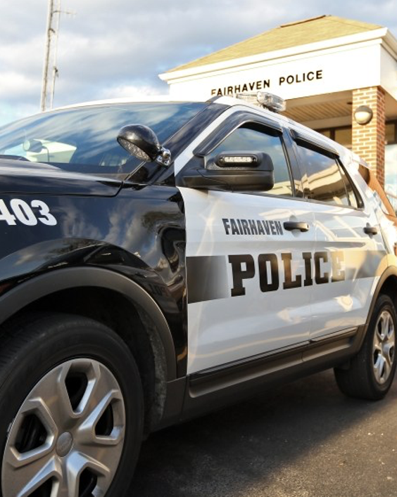

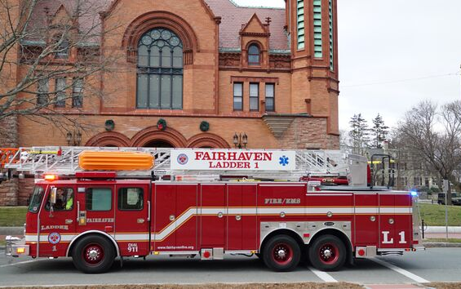
TOWN OF FAIRHAVEN
PUBLIC SAFETY COMPLEX
OCTOBER 2019
REV MARCH 2025

Slide 2
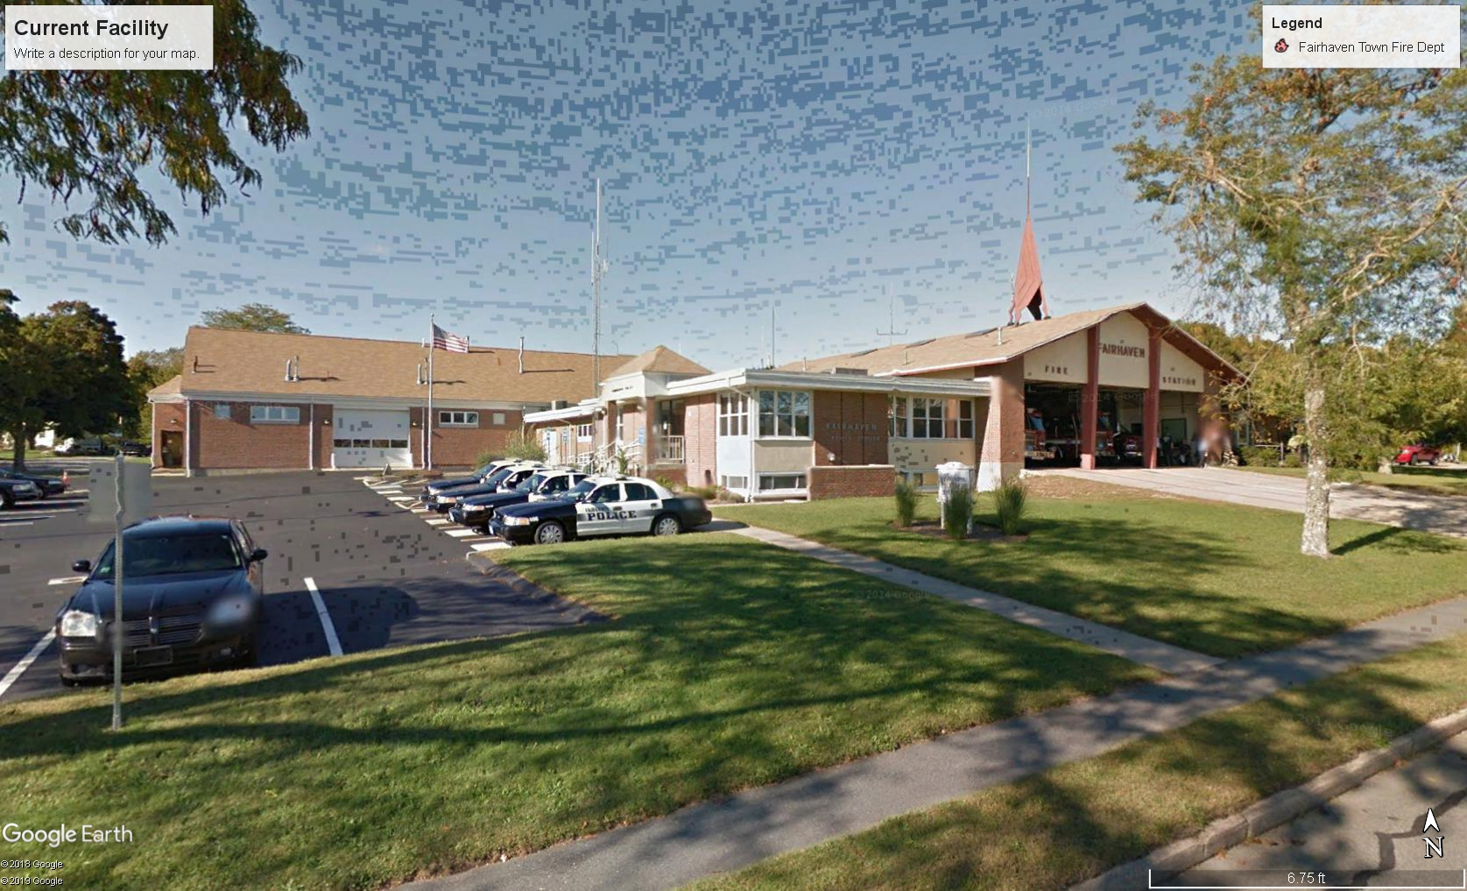
Introduction
The Town of Fairhaven through its Procurement Office is seeking a site for a new Fairhaven Public Safety Complex (PSC)
Possible combination with School Administration
To enhance public safety response
To handle current public safety needs
To meet all DLS (OSHA) requirements, ADA
requirements, and NFPA recommendations.
"Generally the physical space does not appear to support all of the operational needs of the departments. The sizes of the staffs and modern equipment have outgrown the physical space of the building as well as the site." HKT Architects, December 2017

Slide 3
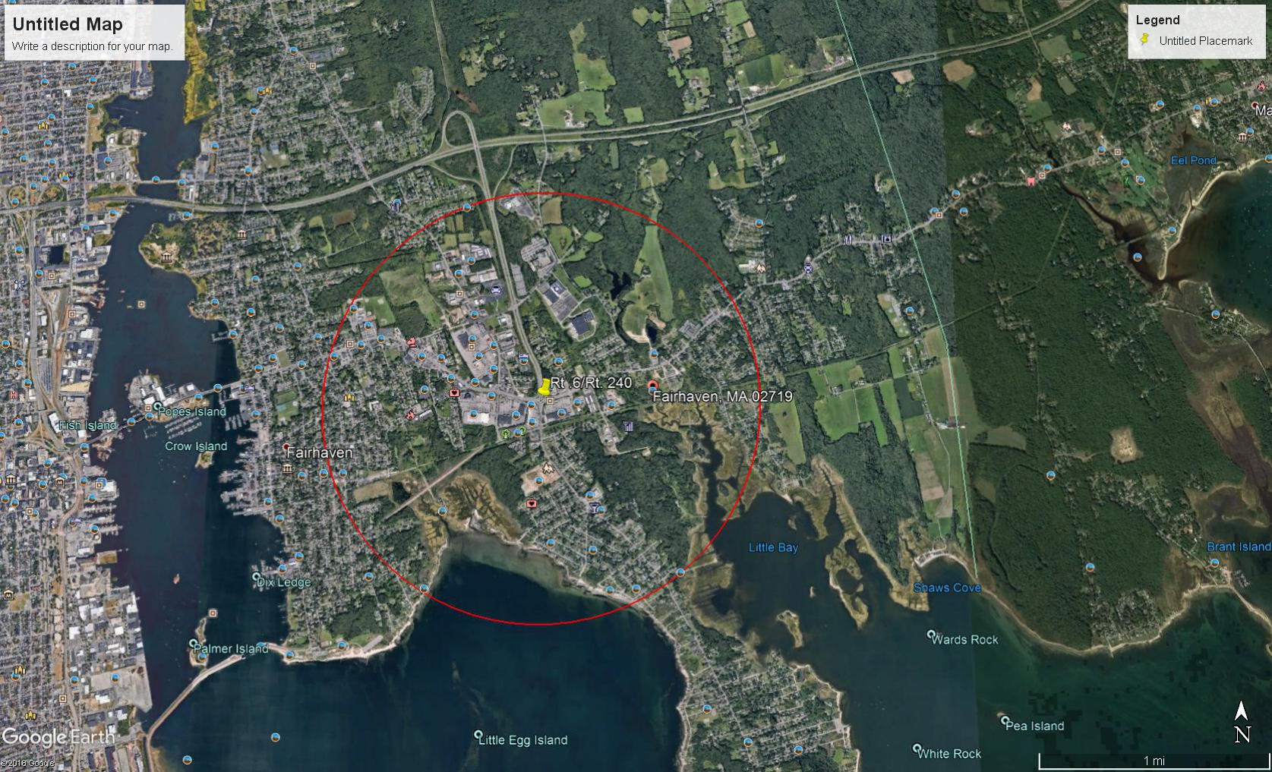

Slide 4
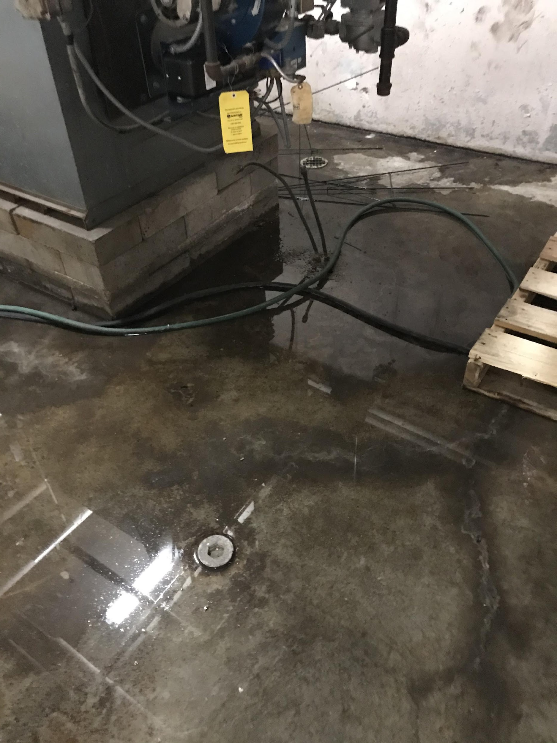
The Evidence
HKT ARCHITECTS FINDINGS
GENERAL
  Water Issues
  Mold Issues
  Not OSHA compliant
  Security
    Public Access/Waiting Areas
    Vehicle Storage/Equipment Storage

Slide 5

The Evidence
HKT ARCHITECTS FINDINGS
ACCESSIBILITY ISSUES
  Customer/Taxpayer Service Counters
  Basement Egresses not compliant
  Temporary Office spaces
  Safety Hazards throughout both buildings
  ADA Compliance/Security issues

Slide 6
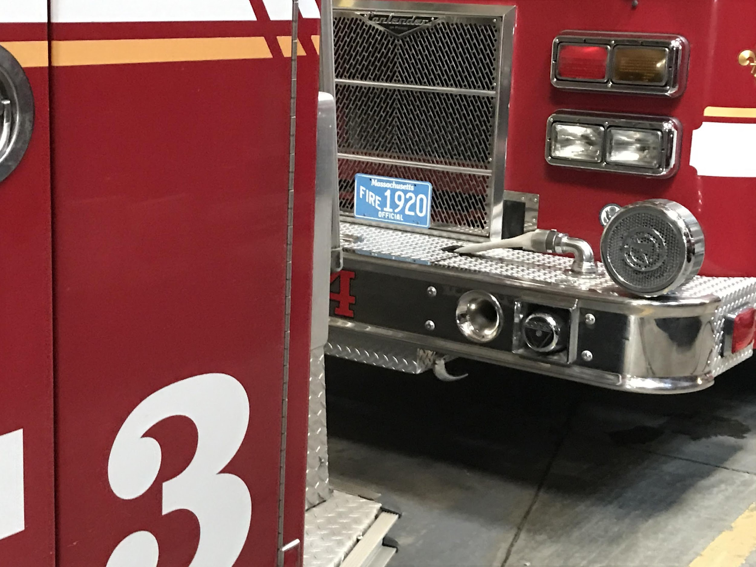
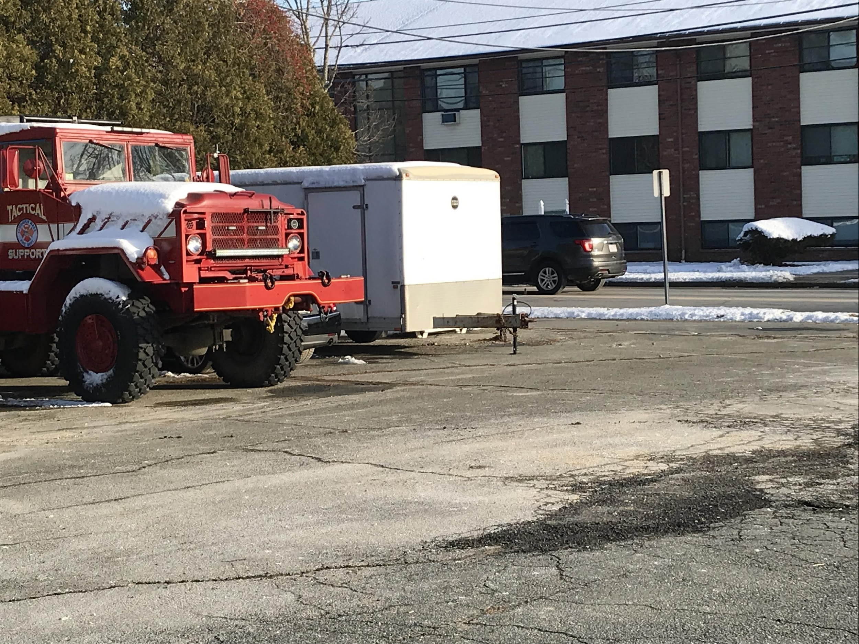
The Evidence
HKT ARCHITECTS FINDINGS
FIRE DEPARTMENT
  Apparatus floor is filled to capacity
  No Dedicated decontamination areas – Cancer Risk
  No dedicated supply areas
  Workshops are undersized and do not meet current code.
  Dorms are at maximum capacity and are not sized for the staff currently on duty
  No conference room, no OIC office space
  Lack of file space.
  No adequate training facility – ISO Rating

Slide 7
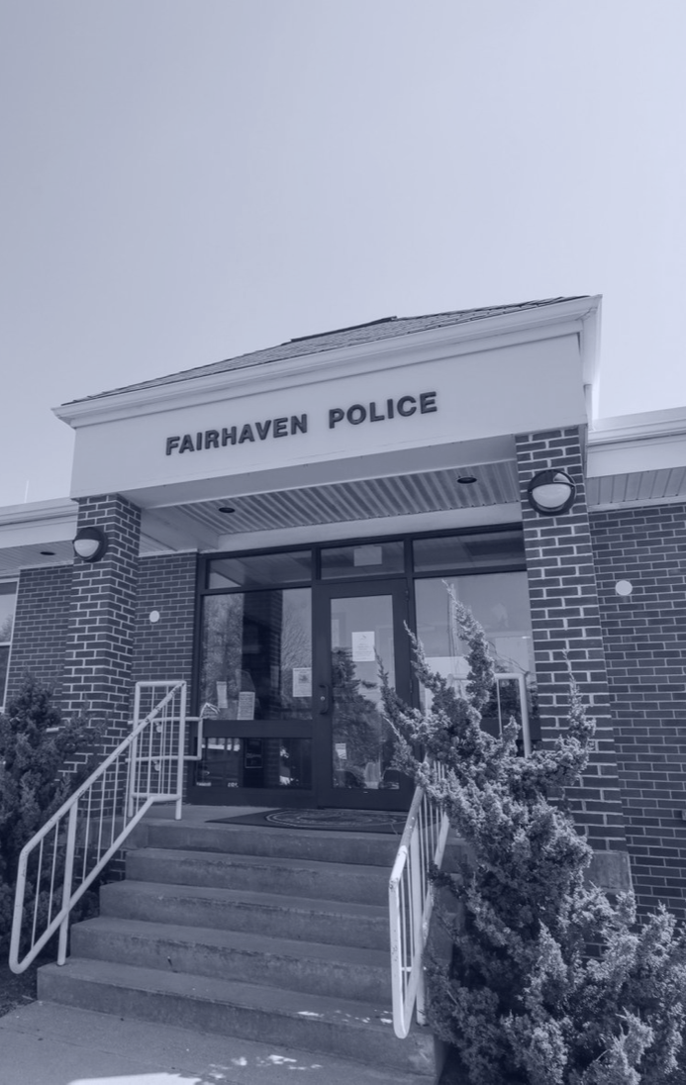
The Evidence
HKT ARCHITECTS FINDINGS
POLICE DEPARTMENT
No firearms/fingerprinting/sex offender registration room.
No cell blocks
No juvenile detention areas
No conference room
Undersized witness interview room
Inadequate size locker rooms
Lack of file rooms/office space
Undersized supply areas
ADA Accessibility issues

Slide 8
The Evidence
Emergency Management (EM)
  Extensive Roof Repairs Needed
  Extensive exterior renovations needed
  Lack of garage space for vehicles/equipment
  Lack of IT infrastructure
  Lack of dedicated supply area
  Lack of Flammable Storage area

Slide 9
The Evidence
HKT ARCHITECTS FINDINGS
FACTS:
Building
Currently 21,880 sqft
Needs assessment recommends 47,000 sqft
Lot
Currently 1.93 acres
Needs assessment of minimum 5 acres
Renovation costs
To renovate the existing building would trigger full accessibility requirements.
Current building has assessed value of $854,200 thus any renovations over $243,447 would trigger full accessibility increasing renovation costs significantly

Slide 10
Recommendations
"If this building is to continue functioning as a police and fire station, it is clear that an addition and extensive reconfiguration of existing spaces will be required to create an appropriate and functioning workspace for both departments.” HKT
“The addition of the Emergency Management Agency, Animal Control, the Harbormaster Division and possibly other public safety agencies like the Health Department or the Building Department would impact any renovation option." - HKT Architects

Slide 11
Timeline History
The Town recognized the need for a modern PSC as early as the 1980’s.
Mid 1980’s – BPW building construction had plans to expand existing building to include a new PSC
1990’s – High School Construction delayed any PSC construction
1997/1998 – Ambulance bay expansion project
2001 – Phase 1 of Fire Department Expansion
2004 - Phase 2 of Fire Department expansion designed.
Mid 2000’s – Phase 2 of Fire Department expansion delayed due to East Fairhaven School needs
2013 – Phase 2 of Fire Department expansion delayed due to Wood School needs.
2014 - Previous Exec Secretary purchase land on Mill Rd for future PSC.
2015 – Police and Fire meet with Town Administrator and Capital Planning to discuss PSC needs.

Slide 12
Timeline History
Additional Space was recognized as early as 1980’s by both Police and Fire.
2016/2017 – HKT hired to do comprehensive study of all town buildings.
2017/2018 – HKT submits report
2018 - Capital Planning Committee deems PSC a priority.
2018 – Evaluation of Town property on Bridge Street (Old Landfill)
2018 - Public Safety Officials evaluate and consider 25 plots.
2019 – Fairhaven releases RFP to purchase property for future site (GB Knowles Site).
2019 (current) – TA & Public Safety Chiefs in negotiations for land purchase (Negotiations Fail).

Slide 13
Timeline History
Additional Space was recognized as early as 1980’s by both Police and Fire.
2020-2021 - COVID Pandemic (Acting TA + New TA) Process stalled
2022/2023 - Sewer Plant upgrade took priority
2024 - Committee Reformed - process resumes

Slide 14
Why a Joint PSC?
Optimize public safety response
Consolidate Buildings/Departments/Infrastructure
Optimize Insurance Service Organization (ISO) Rating
Meet the needs of today’s Public Safety Departments
Meet the needs of tomorrow

Slide 15
Joint PCS Benefits
Public Safety has shared a space since 1964.
Capital/Construction Costs
Allows for interoperability
Allows for joint training needs
Cost of Land/Design
Cost of Project Manager
Overall Cost of Building
Cost of Contract
Cost of Systems – HVAC, Electrical, Fire Protection, ADA
Cost of Equipment

Slide 16
Joint PCS Benefits
Operational Costs
Building Maintenance
Civilian Support Personnel
Energy Costs
Generator Costs
Shared Spaces

Slide 17
Joint PCS Benefits
Shared Spaces
Shared EOC
Shared Communications
Shared Training Room
Shared Training Area
Shared Public Restrooms
Shared Mechanical/Electrical Rooms
Shared Public Meeting Area

Slide 18
LAND NEEDS FOR JOINT PSC
HKT Recommendations:
5 Acres minimum
To meet current needs of Public Safety
Consolidation of several departments
Allow for future expansion needs

Slide 19
LAND REVIEW
MAP | LOT | ACREAGE | REVIEW STATUS
23 | 175 | 40 Acres | Conservation Issues
23 | 175A | 5+ Acres | Conservation Issues
23 | 175D | 4+ Acres | Conservation Issues
23 | 175E | 5+ Acres | Conservation Issues
24 | 017A | 11+ Acres | Cleanup Costs
24 | 15 | 8+ Acres | Conservation Issues
24 | 9 | 8+ Acres | Conservation
24 | 16 | 3+ Acres | Not for Sale
24 | 016A | 3+ Acres | Not for Sale

Slide 20
LAND REVIEW
MAP | LOT | ACREAGE | REVIEW STATUS
25 | 132 | 1+ Acre | Size
25 | 16A | 1-4 Acres | Under Review/Neg
26 | 1 | 12+ Acres | Cleanup
26 | 2 | 5+ Acres | Cleanup
27 | 13 | 13+ Acres | Conservation
30A | 086A | 5+ Acres | Not for Sale
30A | 086B | 1+ Acres | Sold/Size
30A | 87 | 3+ Acres | Sold
30A | 087A | <1 Acre | Size/Sold

Slide 21
LAND REVIEW
MAP | LOT | ACREAGE | REVIEW STATUS
31B | 302 | 35,289 sq/ft | Under Review/Neg
31B | 302A | 14+ Acres | Under Review/Neg
36 | 007S | 1+ Acre | Size
36 | 012C | 4+ Acres | Size/Location
36 | 15 | 4+ Acres | Size/Location
38 | 14 | 4 + Acres | Not for sale
38 | 15B | 3 + Acres | Location/Under Rev.

Slide 22
Separating Police and Fire/EMS/EM
HKT Estimates increase cost of 5 to 10 million to building two seperate buildings
Due to duplication of shared spaces, utilities, meeting areas, and generators
Two seperate construction costs
Land purchase for two separate facilities could add additional expenses
Public Safety Concerns:
Decrease efficiency
Decrease interoperability.

Slide 23
Why now?
Preparing for the near future
  Secure funds for the land purchase, design costs
  Form a public committee to formalize the process - OPEN/TRANSPARENT
  Provide good estimated cost for the taxpayers.
2028 - East Fairhaven Debt Paid
2032 - Wood School Debt Paid
GRANTS - MASSACHUSETTS
“PUBLIC SAFETY BUILDING AUTHORITY”
  Massachusetts Senate Bill S.1641
  Filed (02/2025)
GRANTS - FEDERAL
  FEMA

Slide 24
ARTICLE 20A: Create Public Safety Complex Stabilization Fund
To see if the Town will vote to create a Public Safety Complex Stabilization Fund under Massachusetts General Laws, Chapter 40, Section 5B, effective for fiscal year 2026, beginning on July 1, 2025. This fund will be utilized for the acquisition of land and for the preliminary design of a Public Safety Complex with possible inclusion of the School Administration facility; or take any other action relative thereto.
⅔ vote required (see Page 1/2)

Slide 25
ARTICLE 20B: Public Safety Complex Stabilization
To see if the Town will vote to transfer the sum of $4,000,000 from the Capital Stabilization Fund to be deposited in the Public Safety COmplex Stabilization Fund as authorized by Massachusetts General Laws, Chapter 40, Section 5B, or take any other action relative thereto.
⅔ vote required (see Page 3)

Slide 26
Appropriations from Public Safety Stabilization Account
Chapter 77 of the Acts of 2023, appropriations for a special purpose stabilization fund must only be approved by majority vote.
Majority Vote (see Page 1)

Slide 27
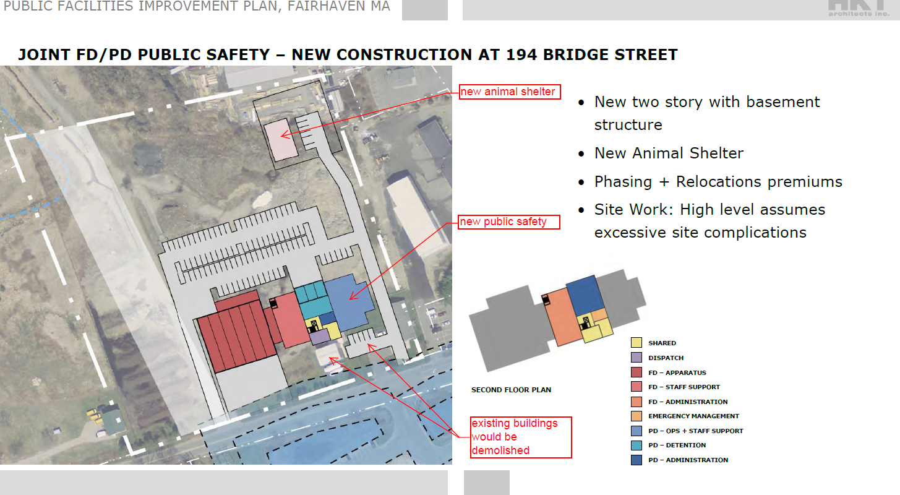
Conceptual Layout - Bridge St.

Slide 28
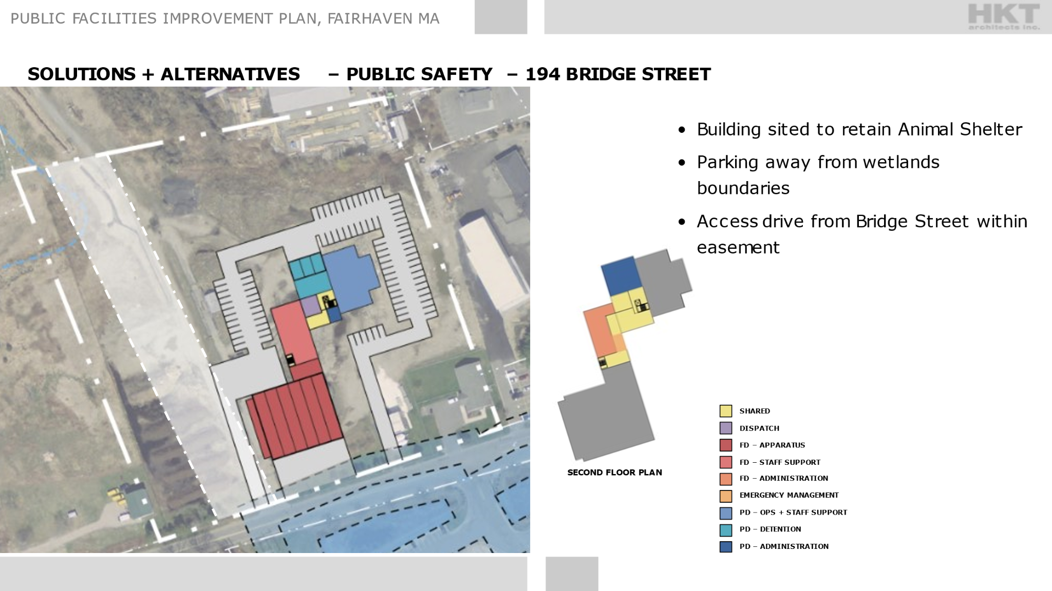
Conceptual Layout - Bridge St.

Slide 29
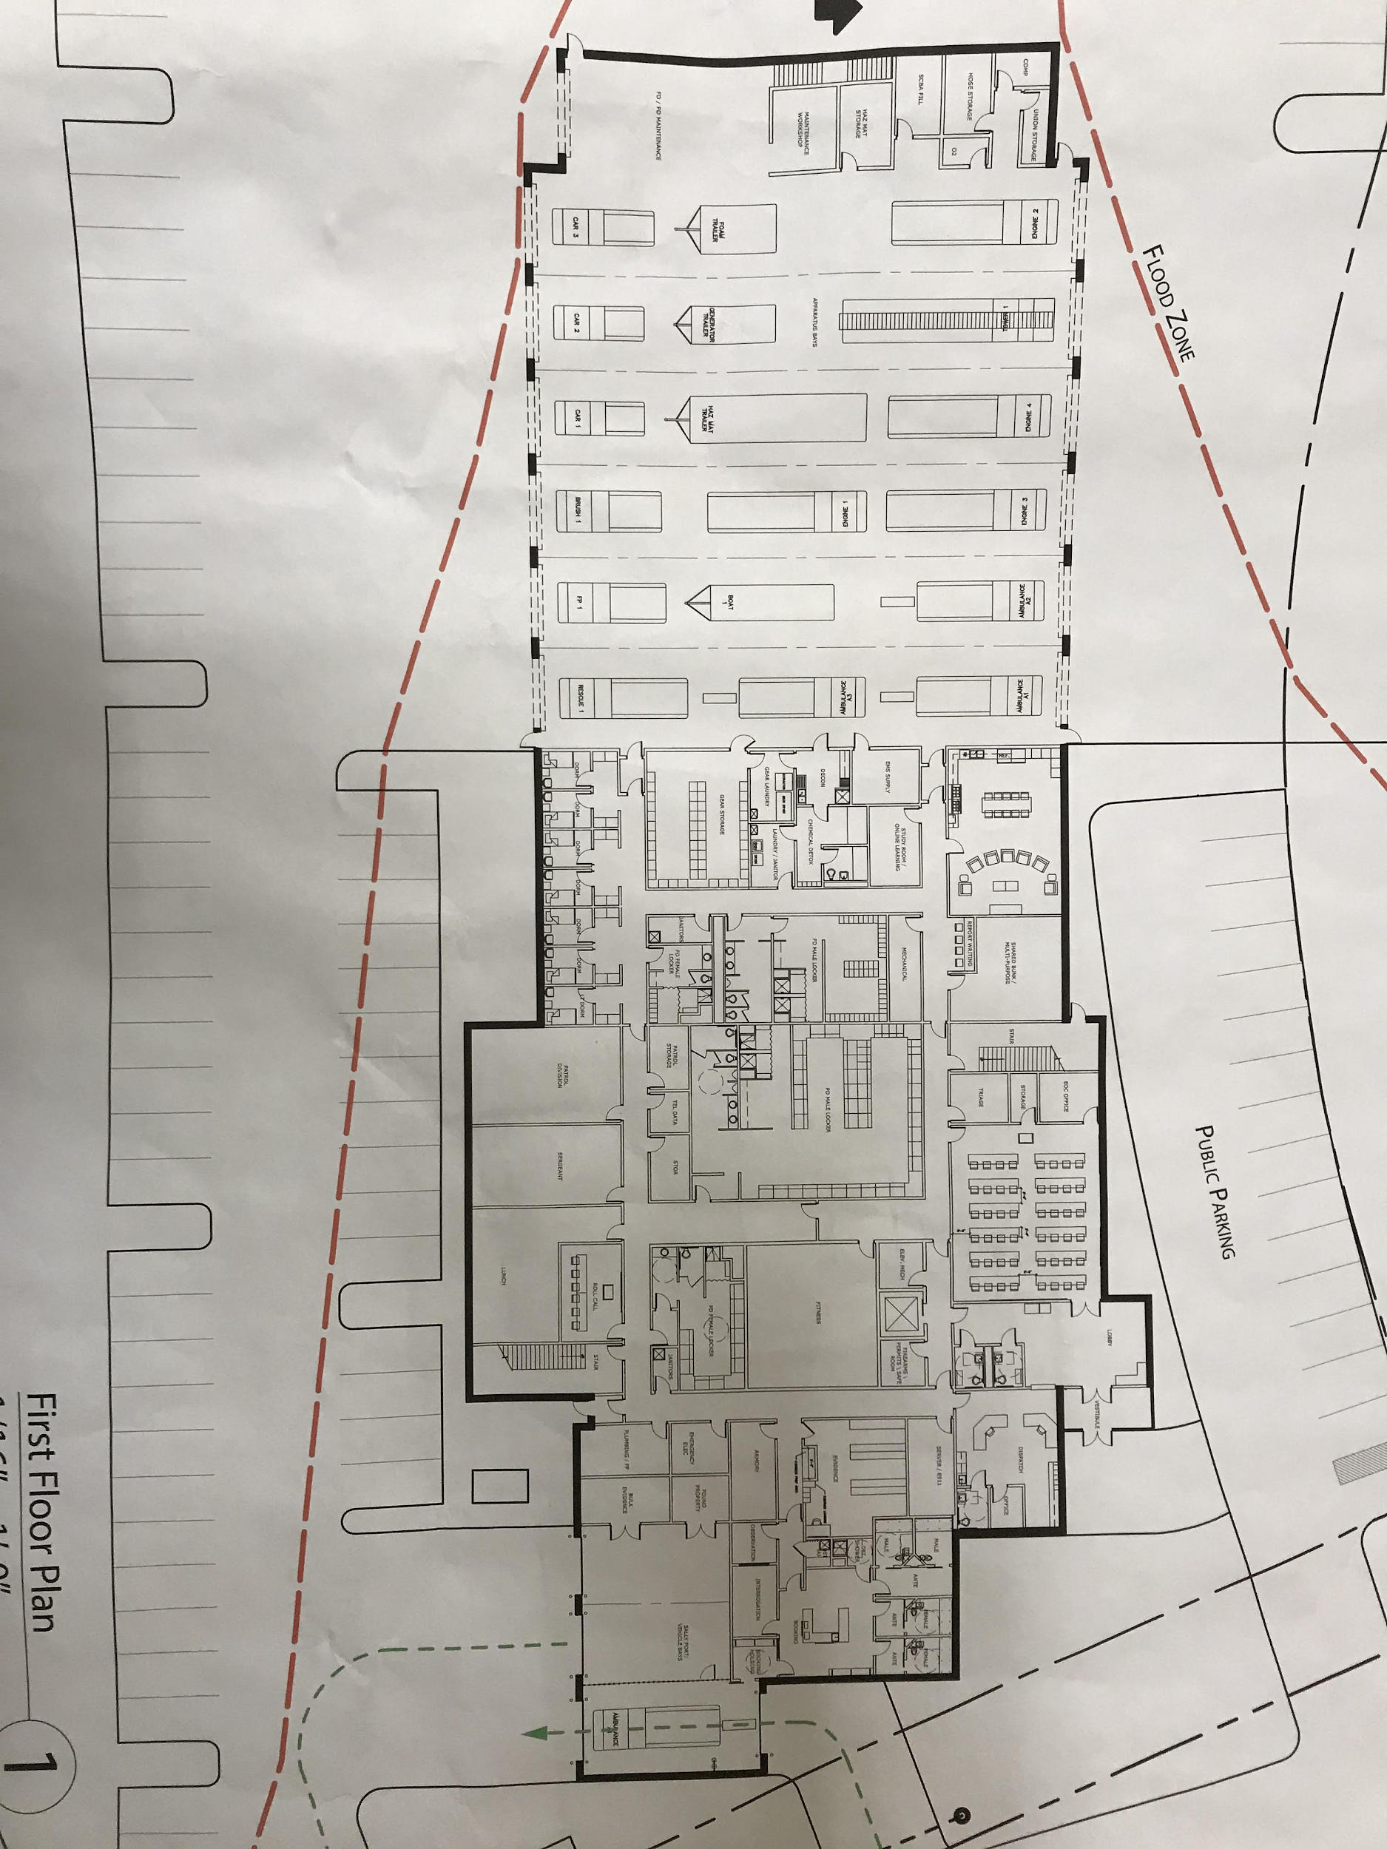
Schematic Drawings of Possible Layout

Slide 30
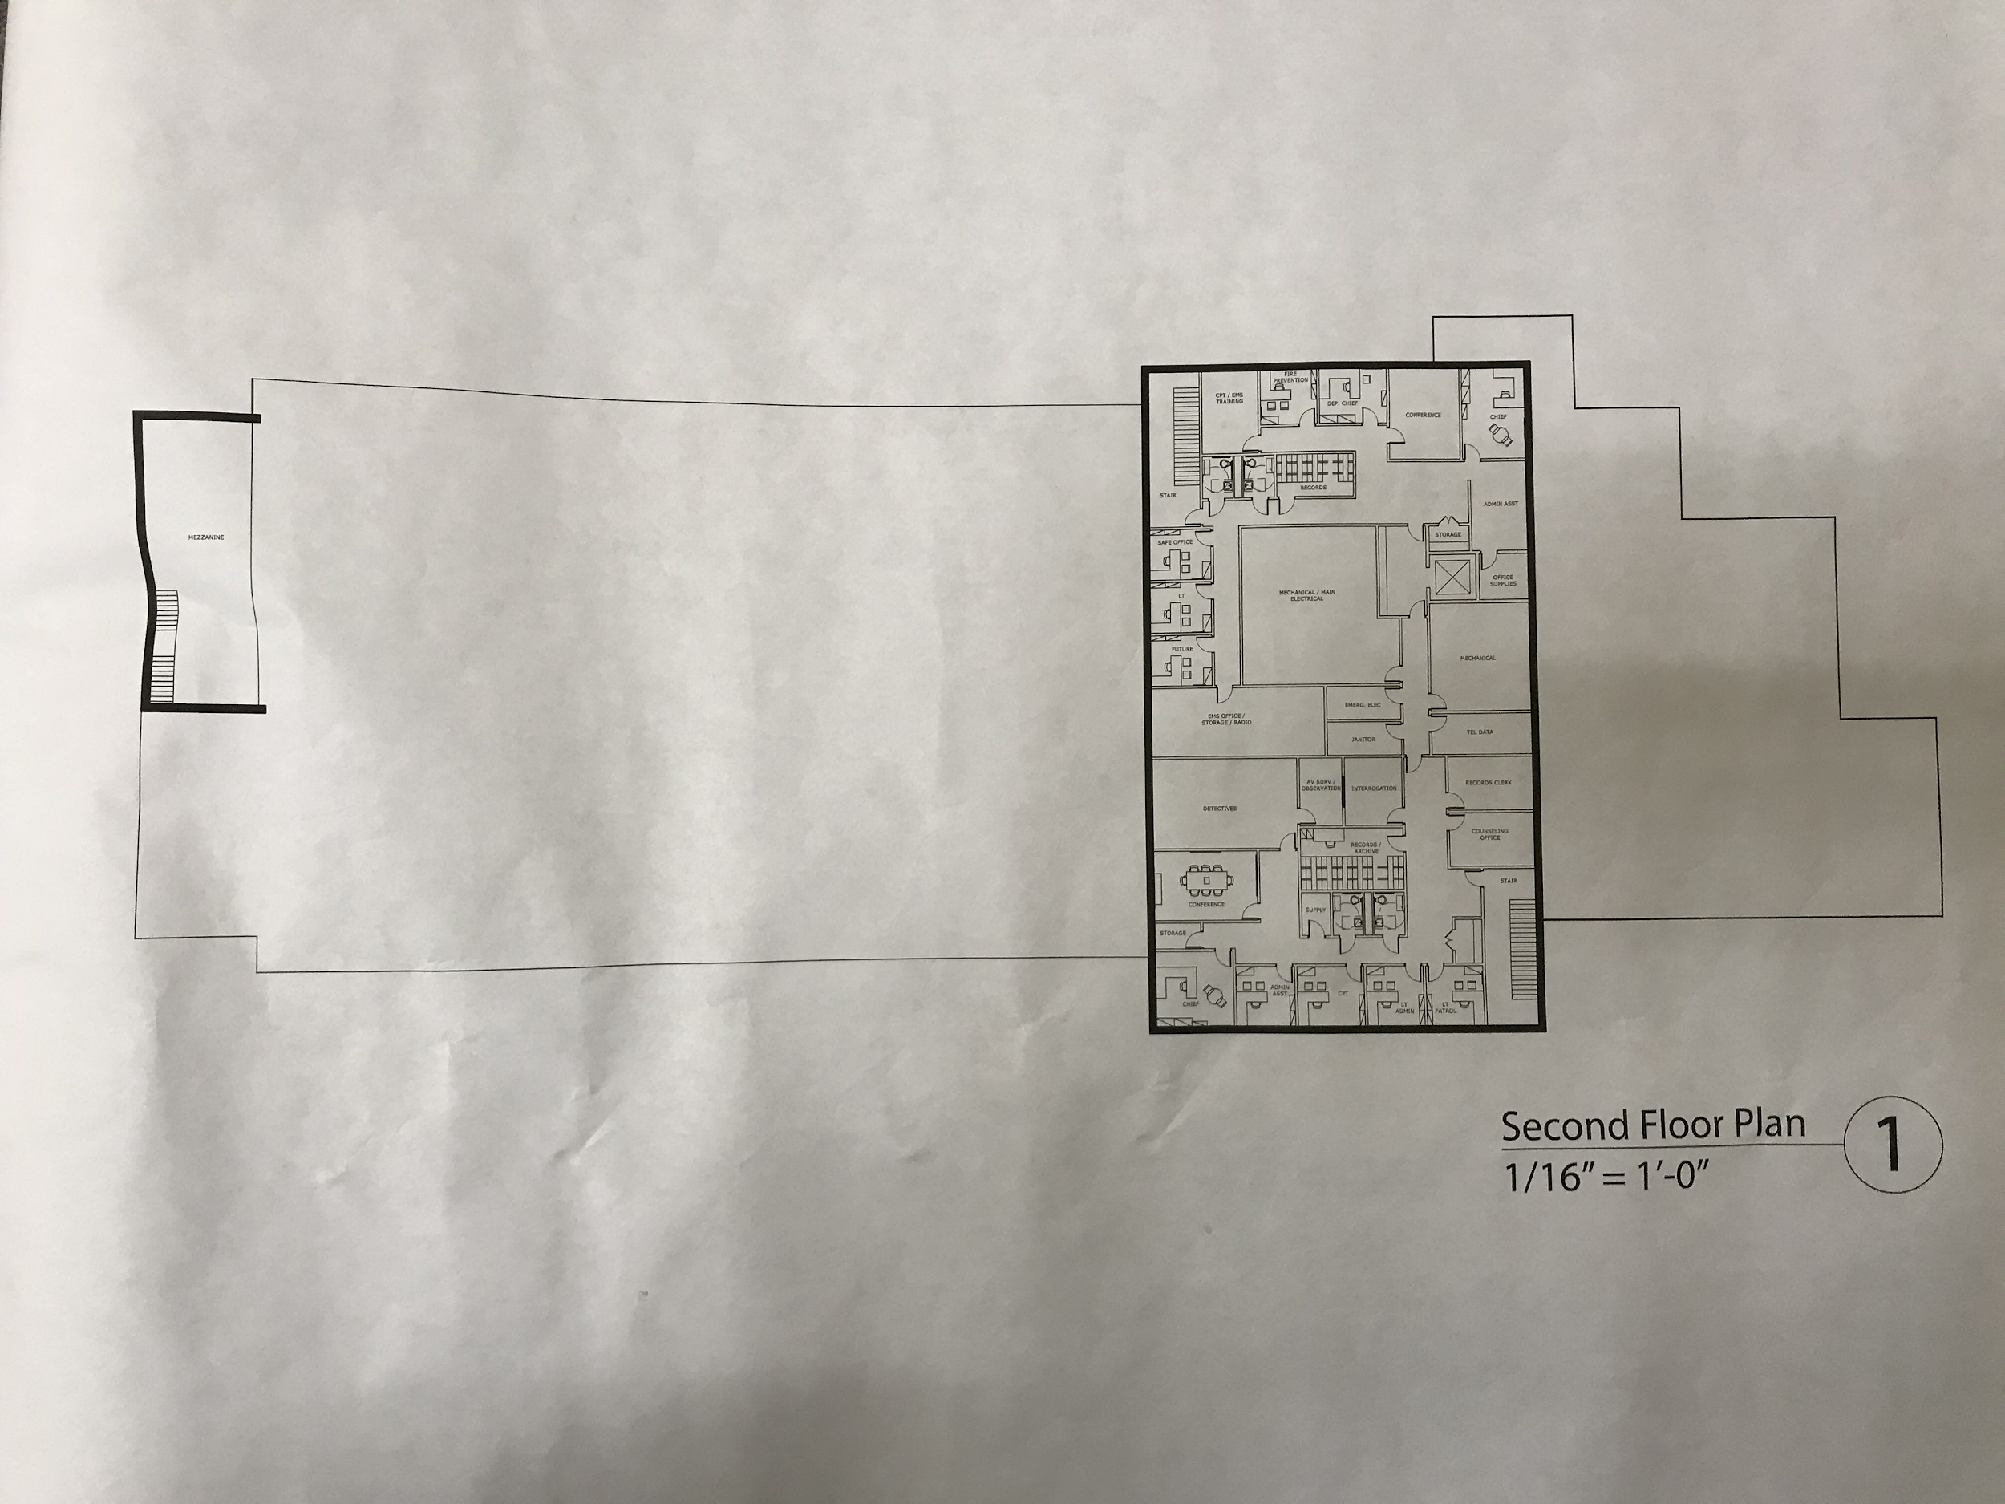
Schematic Drawings of Possible Layout

Slide 31
Questions?

